Slide 1
Requirements Engineering Stakeholders
Week 6

Slide 2
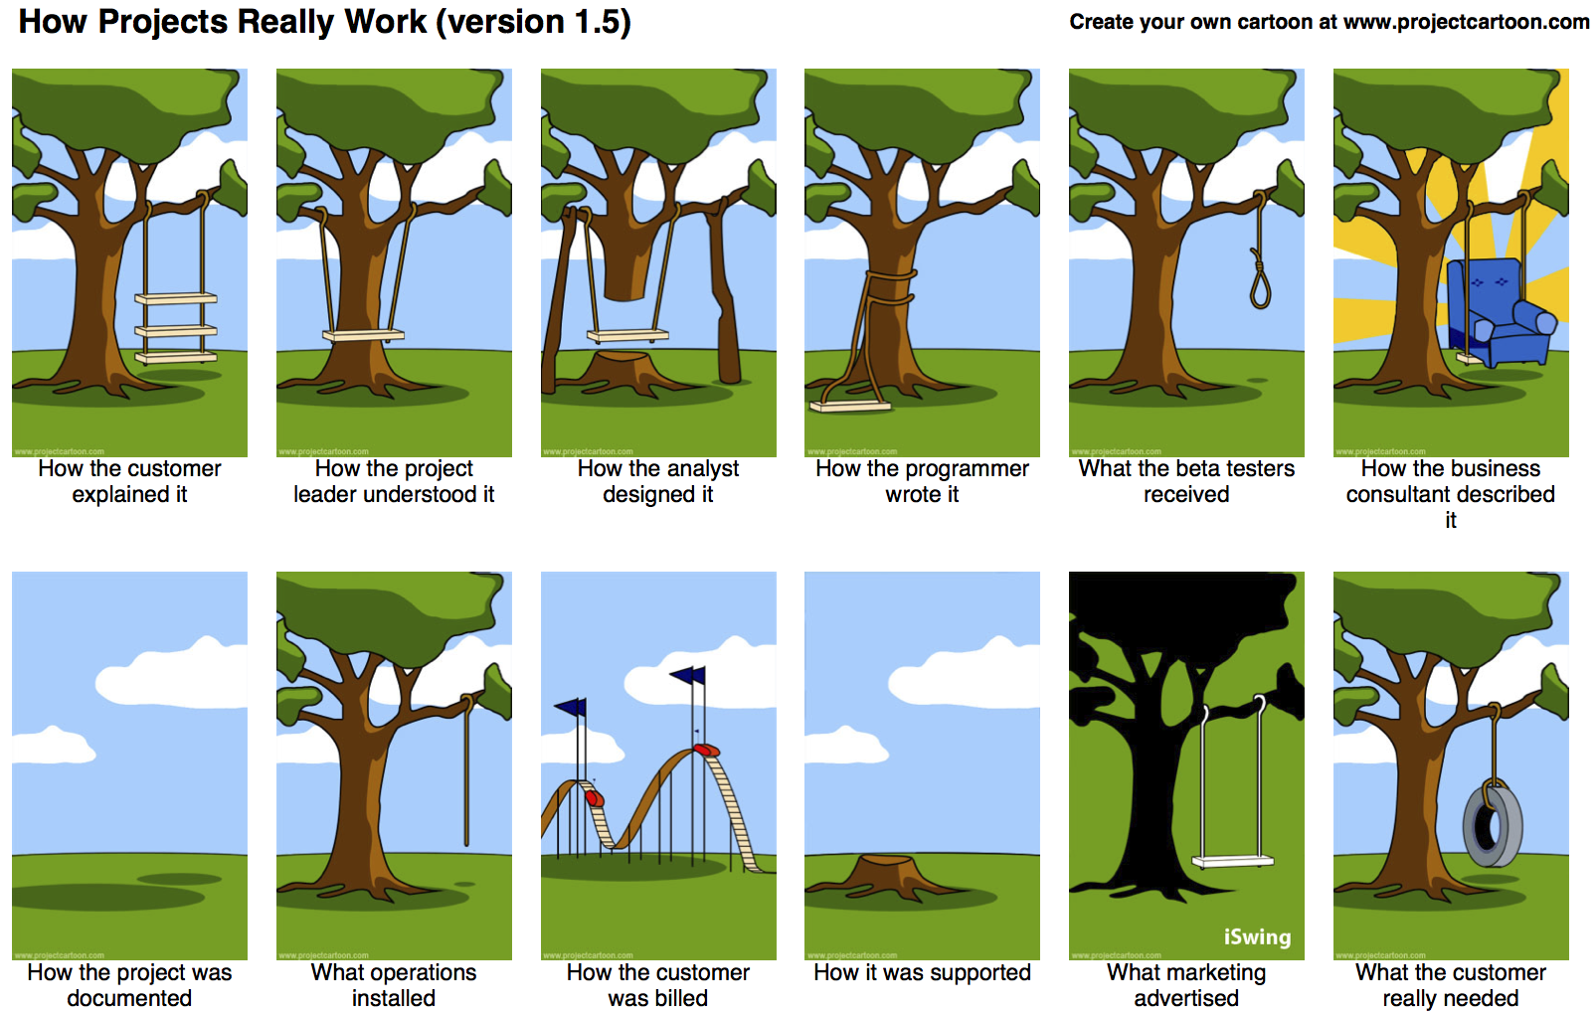

Slide 3
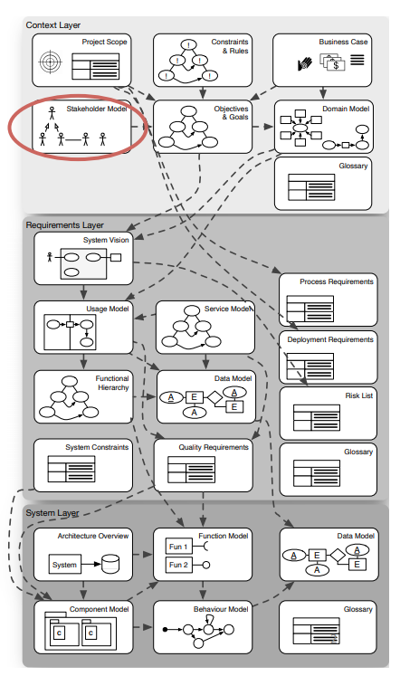

Slide 4
Requirements Management Planning Success Factors
The success factors which are considered vital to maximize the effectiveness of the requirements planning process and increase the likelihood of project success.
1. Organizational Commitment
2. Recognizing the Value of Requirements Management Planning
3. Stakeholder Engagement and Collaboration
4. Integration with Project Management Activities

Slide 5
Stakeholder Engagement and Collaboration
Stakeholders should be engaged early and often throughout the life cycle.
Stakeholder analysis is often conducted during the planning domain so the project team can understand the stakeholder impacts and influences on the requirements process as early as possible
This analysis is performed iteratively and is revisited throughout the project as new stakeholders are discovered or existing stakeholders are determined to no longer be impacted by the proposed solution.
Lack of stakeholder analysis and engagement may lead to incomplete, incorrect, or missed requirements.

Slide 6
Stakeholders
Directly affected by the system
Have interest in the system under development
Definition:
A stakeholder is a person or organization who influences a system's requirements or who is impacted by that system.
Addition:
Interest in the system does not necessarily mean interest in project success (Example: legislation, staff association)

Slide 7
Critical points
Role of Stakeholders with respect to the system under development
– Relevant for project success
– Priority of stakeholder
– Type of interest
– Skill in phrasing interests/requirements
Role of Stakeholders with respect to project and project organization – Reporting
– Decision competences

Slide 8
Phases of Stakeholders
What is a stakeholder?
Identifying stakeholders
Classifying stakeholders
Analyzing stakeholders
Managing stakeholders

Slide 9
Step 1: Identifying
Clients (who pays)
Future user groups
Maintains
Legislature
i) Phases: Analyzing the aspects and development phases of software systems development to find the responsible roles. This approach is an easy way to set up early elicitation meetings with the most important, rather obvious stakeholders.

Slide 10
ii) Reference list: Instantiating generic reference lists of stakeholders for the concrete project context.
This second step takes standard roles into account that have been included in reference models and enhance the initial quick list of stakeholders.
One simple reference model that is being used in software engineering to map out stakeholders is the so called Onion Model with its four concentric spheres: product, system, containing system, and the wider environment.

Slide 11
iii) Context: Inspecting the business and operational context of the system under development, and understanding which concrete roles are involved.
This step makes sure that the specifics of the project under consideration are all met and special roles are considered.
iv)Goals: Iteratively analyzing and refining a generic goal model and deducing the related roles. This approach is especially suitable for finding passive stakeholders that do not have an active interest in issuing own goals, but whose constraints have to be adhered to, for example legislative representatives.

Slide 12
Step 2: Classifying Stakeholders: Roles
There are different types and roles for stakeholders with different interests and, consequently, differing requirements:
Active / Passive
Phase wise distribution
How much influence they have
Owners (e.g., individual, shareholders, even the public)
Partners (e.g., other companies providing related services)
Department heads, managers
Staff, developers
Regulatory bodies, legislative representatives
Suppliers
Customers
Competitors

Slide 13
All of these stakeholders hold one or more functions with regard to the software system under development:
Decision makers (e.g., sponsors, artefact approvers)
Information providers (e.g., domain experts)
Regulatory (e.g., legal body)
Implementers (e.g., developers, testers)
End users
Post-implementation support (e.g., trainers, managers)

Slide 14
Step 3: Analyzing Stakeholders
Relation between stakeholders.
Stakeholder analysis includes developing a stakeholder model and a stakeholder matrix that gives an overview of the following information:
What is their motivation?
– How much power or influence do they have?
– Are they supporters or detractors of the project?
– Are they fully engaged, or disinterested?

Slide 15
What are their expectations? (needs, concerns, wants)
What do we expect of them? (task and result)
How expert are they at what they do?
Where are they?
What is their availability? (for communication and/or negotiation)
What is their authority? (level of influence, impact, or enhancement)
What is their relation to other stakeholders? (hierarchical and official relations as well as informal friendships or rivalries)

Slide 16
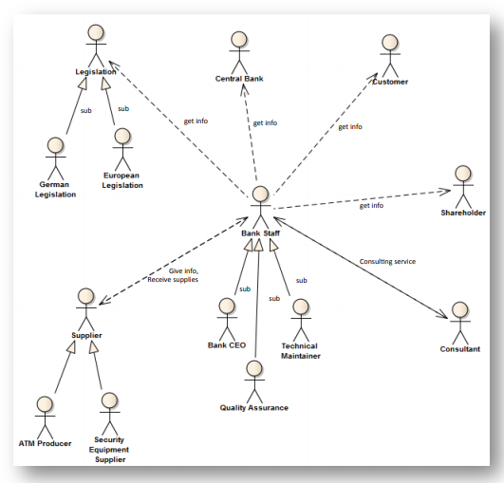
Stakeholder Model

Slide 17
Stakeholder Model
We document the stakeholders in a Stakeholder Model
It allows to list and describe all stakeholders involved in a project.
Stakeholders comprehend individuals, groups, or institutions having the responsibility for requirements and a major interest in the project.
User groups are a specialization of stakeholders interacting with the system.
Means to document Stakeholder Models are UML Actor Hierarchies, informal hierarchical graphics or natural text.

Slide 18
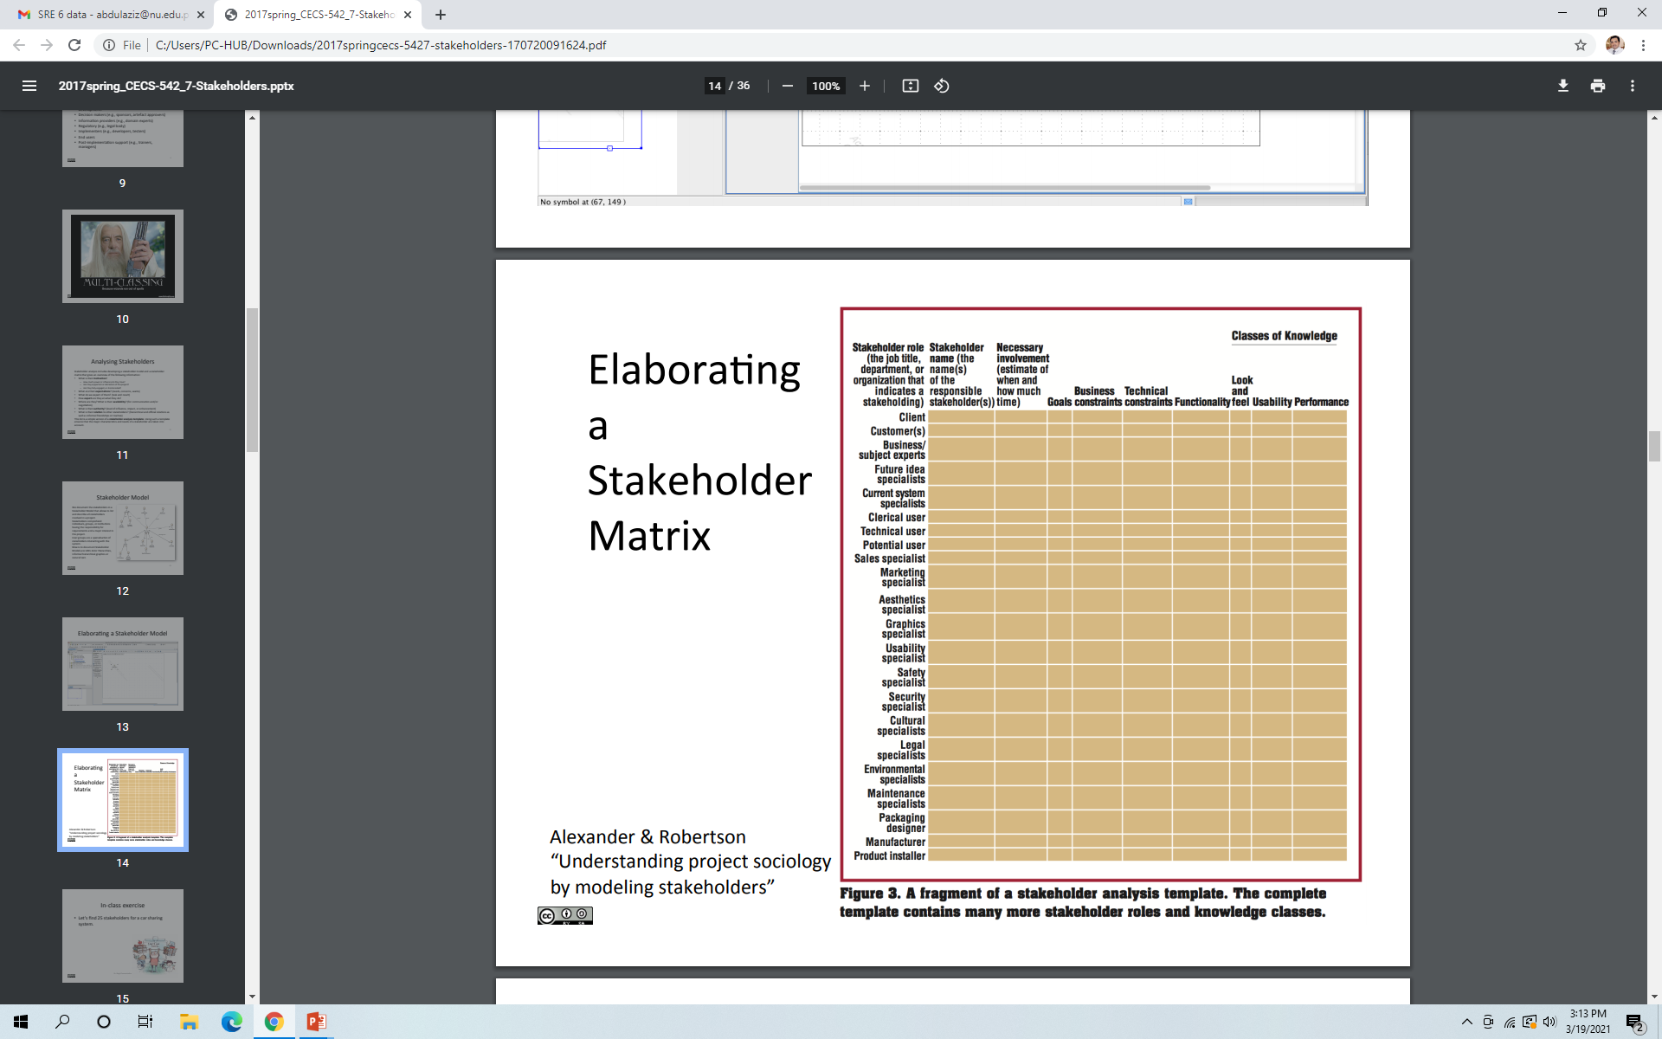

Slide 19
Generate or Refine the Stakeholder Register
An initial stakeholder register may have been developed as a part of the:
Needs Assessment OR
Work to produce the:
Project management plan
Stakeholder management plan
Communications plan OR
Other plan documents.
Whether there is a need to start a new or begin with an existing register of stakeholders, this step analyzes and identifies the stakeholders who will have a role in the requirements process.

Slide 20
Generate or Refine the Stakeholder Register
The register may include stakeholders such as those who will:
Provide sponsorship for the project;
Benefit from the project outcomes;
Be responsible for the project outcomes;
Define the product service or result;
Provide support
Articulate the benefits;
Provide financial backing;
Use the solution; and
Implement the solution.
After the register is generated and reviewed, the stakeholders are characterized and grouped.

Slide 21
Group and Characterize Stakeholders
Once the stakeholder register is complete, an analysis of the characteristics of the identified stakeholders should be performed.
Some commonly applied characteristics for consideration are:
Attitude
Complexity
Culture
Experience
Level of influence
Location And
Availability.
Brief descriptions of these are in Section 3.3.2 of Business Analysis for Practitioners:A Practice Guide.

Slide 22
Group and Characterize Stakeholders
Once characteristics are understood, stakeholders can be grouped.
Groupings can be structured by similar interests, common needs, level of importance, etc., but are used to help identify unique groups for eliciting requirements.
It is important to make sure that there are clear roles, responsibilities, and accountabilities; therefore, a single primary contact should be identified for each task.

Slide 23
Group and Characterize Stakeholders
A commonly used approach to organizing these assignments, known as either RACI or ACRI, characterizes and groups stakeholders into one or more of four categories:
Responsible: Person(s) performing the work.
Accountable: Person(s) approving the work or assigning a delegate to approve for them.
Consulted: Person or group (often subject matter experts) to be consulted for input.
Informed: Person or group to be apprised of progress.

Slide 24
Group and Characterize Stakeholders
Some expansions are RASIC or CAIRO:
Support: Person(s) who will support Responsible.
Omitted: Person(s) who are not part of the task

Slide 25
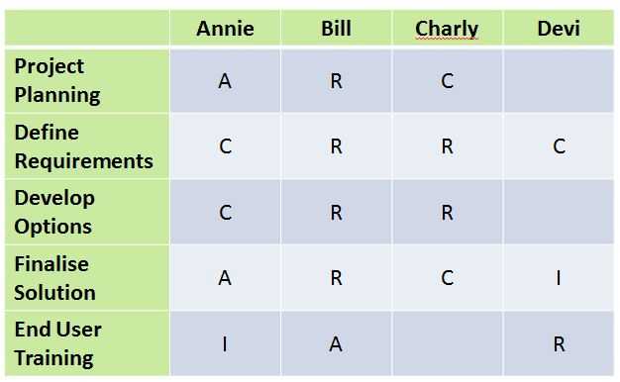
Group and Characterize Stakeholders

Slide 26
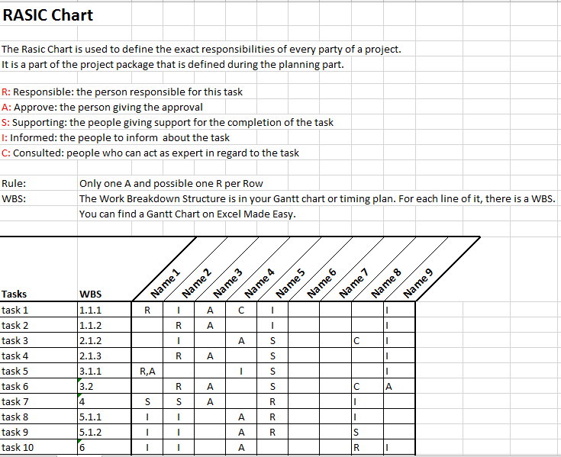
Group and Characterize Stakeholders

Slide 27
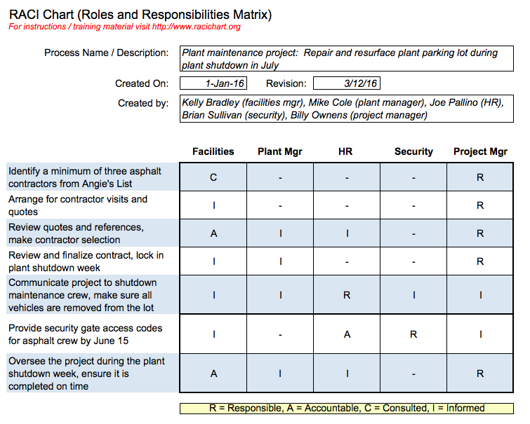
Group and Characterize Stakeholders

Slide 28
Group and Characterize Stakeholders
Once the stakeholder register is reviewed and approved, the information collected in this step can be later documented in the requirements management plan.
As stakeholders change over the course of the project, the register is updated to reflect the current stakeholders.

Slide 29
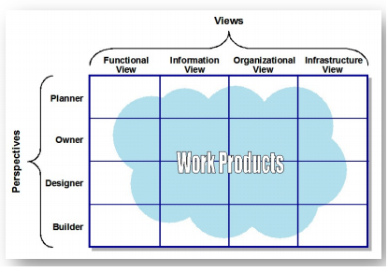
Viewpoints

Slide 30
Step 4: Managing Stakeholders
The most important factor in stakeholder management is communication.
The challenge is to establish a stakeholder management strategy that addresses the stakeholders' information needs: who, what, how, when and why.
In order not to overwhelm the stakeholder with information, concise communication is preferable, and for successful communication it is crucial to encourage feedback.
There are a number of different communication means that might be suitable, for example consider workshops, interviews, phone calls, web, etc.
A blend of what works best depends on the project settings but it has to be ensured that communication is two-way.
Once communication is well established, the information flow needs to be kept up to date in the stakeholder model or matrix – whichever representation was chosen and works best.

Slide 31
Manage Stakeholder Engagement
Through proactive communication and working directly with stakeholders to meet the project objectives, stakeholders are engaged and managed throughout the requirements life cycle process.
It is important to:
Understand their needs and expectations
Address issues as they arise And
Foster the appropriate engagement throughout the life cycle in order to:
Gain increased support And
Reduced resistance
To significantly increasing the chance to achieve project success.

Slide 32
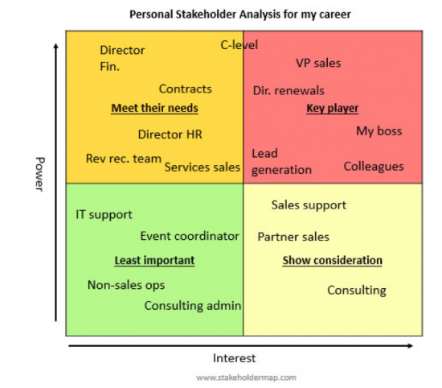
Manage Stakeholder Engagement
High power, less interested people:
Keep these stakeholders satisfied,
but not so much that they become
bored with your message.
High power, highly interested people:
Fully engage these people,
and make the greatest efforts
to satisfy them.
Low power, highly interested people:
Adequately inform these people,
and talk to them to ensure that no major issues arise. People in this category can often be very helpful with the details of your project in a supportive role.
Low power, less interested people:
Again, monitor these people,
but don’t bore them with
excessive communication.

Slide 33
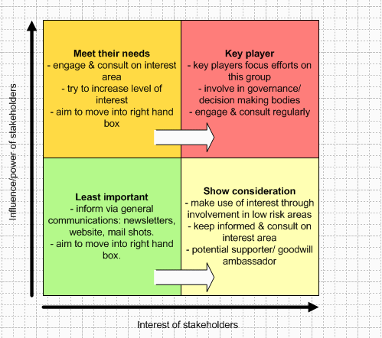
Manage Stakeholder Engagement

Slide 34
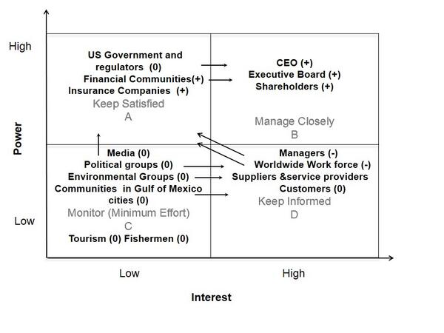
Manage Stakeholder Engagement

Slide 35
Onion Model
Identifying stakeholders involved in your project. Helps the BA determine which stakeholders will directly interact with a system or process and those outside the organization.
To develop a Stakeholder Onion Diagram, identify the following categories of stakeholders:
Layer 1: Stakeholders closely involved in the creation of the product, which could be a new system or a new process. Stakeholders may include the project manager, software developer, business analyst, etc
Layer 2: Stakeholders whose work changes when the solution is defined. For example, end users.
Layer 3: Sponsors, executives and subject matter experts who interact closely with the system
Layer 4: External Stakeholders such as customers, regulators, government, suppliers and the like.

Slide 36
General Template
Customer
Regulator
Supplier
Competitor
SME
Sponsor
Executive
Trainer
User
System Admin
Helpdesk
BA
Developer
Tester
PM
Software System

Slide 37
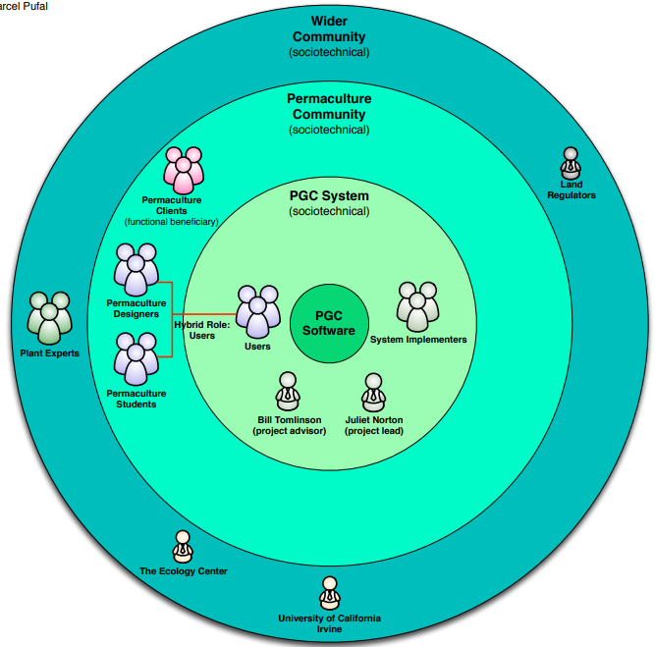
Example

Slide 38
Case Study as Example

